Slide 1
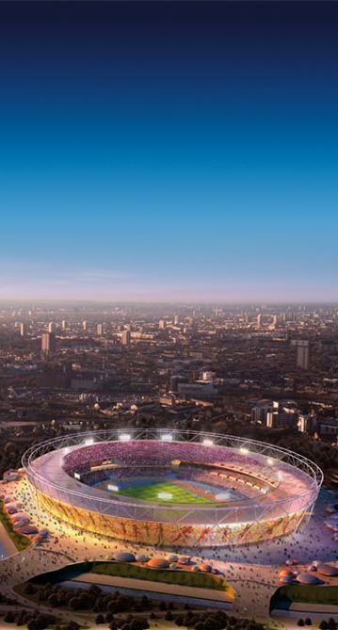
London Olympic Games
From July 2012, the mobile industry is expecting to cater for 80m mobile users across 100 venues; an unprecedented number of people using their devices in ‘spikes’ of activity around the event times
We’ve been planning the detail of the Games for over 2 years and have already invested more than £50m
Using Twickenham as our ‘prove’ ground we’ve found a way of putting up to 10x more capacity into stadia – a world first
We work with the other mobile operators to ensure the best possible customer experience at the Olympic venues
In the Olympic Stadium alone, we’ve put enough coverage in to cater for a city the size of York
Notes:
1
1
1
1

Slide 2
London Olympic Games
Wi-Fi
BT has an exclusive relationship to provide Wi-Fi at the venues however we’ve negotiated a deal with BT so our customers can use their Wi-Fi without charge
Legacy
We’re boosting the network at games venues but also key hot spots around the city
This means business’ will see a lasting benefit to coverage and data capacity
Notes:
2
2
2
2

